Slide 1

Department of Computer Science and Design
Session 2025-26
PQAI-II (Project Phase – II)
A Hybrid Firefly–Antlion Optimizer with Energy-Aware Load
Balancing for Sustainable Cloud Scheduling
Presented By Group No : 01
Ms. Aarohi Waghmare (Roll no : 01)
Ms. Diksha Bhagwat (Roll no : 08)
Ms. Giteshwari Lanjewar (Roll no : 09)
Ms. Sanchyee Pendam (Roll no : 19)
Ms. Srushti Bawane (Roll no : 25)
Ms. Vaishnavi Rathod (Roll no : 29)
Guided By
Dr. Amol D. Gaikwad
Ms. Apurva A. Bodkhe
A Hybrid Firefly–Antlion Optimizer with Energy-Aware Load Balancing for Sustainable Cloud Scheduling

Slide 2
Abstract
Maintaining cloud computing performance and energy efficiency requires effective load balancing. Poor scalability, excessive energy use, and unequal job distribution are common problems with traditional scheduling techniques. To overcome these difficulties, this thesis suggests A Hybrid Firefly Antlion Optimizer (FAO) with Energy Aware Load Balancing. The hybrid model ensures balanced and flexible work scheduling by combining the exploration power of the Antlion Optimizer with the refinement capacity of the Firefly Algorithm. The system improves throughput, response time, and resource usage while lowering power consumption by using an energy efficient approach. The outcomes demonstrate the model's promise for scalable and sustainable cloud computing
A Hybrid Firefly–Antlion Optimizer with Energy-Aware Load Balancing for Sustainable Cloud Scheduling
2

Slide 3
Introduction
Efficient load balancing is essential for performance and energy efficiency in distributed systems.
Traditional methods often fail to distribute workloads evenly and consume excessive energy.
The Hybrid Firefly–Antlion Optimizer (FAO) combines local search (Firefly Algorithm) and global exploration (Antlion Optimizer).
This hybrid approach ensures balanced task allocation and reduces energy consumption.
Results show optimized resource use, better scalability, and improved system performance.
It improves accuracy in task scheduling and decision-making.

Slide 4
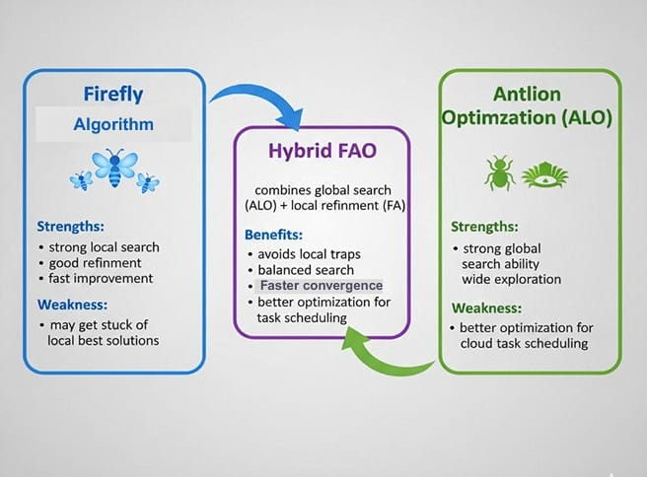
o
4

Slide 5
Problem Definition
In distributed computing, achieving high accuracy, balanced task distribution, and energy efficiency is a major optimization challenge. The existing Hybrid Firefly–Antlion Optimizer (FAO) model suffers from low accuracy, uneven task allocation, and high energy consumption, affecting performance and scalability. Traditional optimization and metaheuristic methods fail to balance global exploration and local exploitation, leading to poor resource utilization. Hence, there is a need to enhance the FAO model using machine learning–based optimization and energy-aware mechanisms to improve accuracy, efficiency, and energy performance in large-scale dynamic systems.

Slide 6
Aim and Objectives
Aim
Design and implement a Hybrid Firefly–Antlion Optimizer (FAO) with energy-aware load balancing to efficiently distribute workloads, minimize energy consumption, improve resource utilization, and enhance overall system performance in distributed/cloud environments.
Objectives:
To minimize energy consumption and improve performance by developing an energy-aware load balancing mechanism
To enhance resource utilization and task execution efficiency through dynamic workload management.
To improve load balancing across virtual machines.
To minimize makespan and enhance task execution speed.

Slide 7
Literature Review
Sr. No. 1. | Title of the paper Optimizing Cloud Load Balancing with a Hybrid Bio-Inspired Approach: Enhancing Performance and Scalability | Author Salam Al-E’mari – University of Petra, Jordan Yousef Sanjalawe – The University of Jordan Budoor Allehyani – Umm Al-Qura University, Saudi Arabia | Year of Publication/ Publisher 2025 (Presented at the 1st International Conference on Computational Intelligence Approaches and Applications - ICCIAA 2025) | Major observations/findings Hybrid SSA–EHO: Uses SSA for exploration and EHO for exploitation/clustering. Outperforms traditional algorithms (RR, PSO, ACO, GA, LH-PSO, HFTO, EWSO) with: Better load balancing Lower response time Higher resource utilization Improved scalability Reduced energy consumption | Research Gap Existing load balancing algorithms, including both traditional and bio-inspired ones (e.g., PSO, GA, ACO, ABC), have major limitations Premature convergence High computational complexity Inefficiency in dynamic and heterogeneous cloud environments Over-dependence on parameter tuning

Slide 8
Literature Review
Sr. No. | Title of the paper | Author | Year of Publication/ Publisher | Major observations/findings | Research Gap
2. | A Novel Hybrid Load Balancing Method to Achieve Quality of Service (QoS) in Cloud-Based Environments) | Author : Mahak Shrimal (M.Tech Scholar, GITS Udaipur) Ajay Kumar Sharma (Professor & Head, CSE, GITS Udaipur) Dr. Mayank Patel (Professor, CSE, GITS Udaipur) | Publisher: IEEE 2024 (Presented at the 3rd International Conference on Sentiment Analysis and Deep Learning - ICSADL 2024) | Proposed a hybrid load balancing technique combining Static Round Robin and Dynamic Ant Colony Optimization (ACO). Achieved better average response time (95ms) and resource utilization (80%) than static (120ms, 70%) and ACO-only (85ms, 90%). | Static algorithms lack adaptability to real-time changes. Dynamic methods can be unstable or computationally heavy.
A Hybrid Firefly–Antlion Optimizer with Energy-Aware Load Balancing for Sustainable Cloud Scheduling

Slide 9
Literature Review
Sr. No. | Title of the paper | Author | Year of Publication/ Publisher | Major observations/findings | Research Gap
3. | Simulation Design of Load Balancing Optimization for Cloud Computing Data Stream Storage Based on Big Data Algorithms | Jing Gao, Shandong Polytechnic College, China | Publisher: IEEE 2024 (Presented at the Asia-Pacific Conference on Software Engineering, Social Network Analysis and Intelligent Computing – SSAIC 2024) | Analyzes historical load data of storage nodes. Predicts future load conditions using big data techniques. Dynamically allocates data to nodes with lighter loads, optimizing overall balance. | Are limited in processing power for large-scale, real-time data streams. Often fail under uneven or skewed data flow conditions. Struggle with dynamic load changes and node energy consumption.
A Hybrid Firefly–Antlion Optimizer with Energy-Aware Load Balancing for Sustainable Cloud Scheduling

Slide 10
Literature Review
Sr. No. | Title of the paper | Author | Year of Publication/ Publisher | Major observations/findings | Research Gap
4. | An Advanced Multi-Model Cloud Services using Load Balancing Algorithms | Author: Raghunadha Reddi Dornala | Publisher: IEEE 2023 5th International Conference on Inventive Research in Computing Applications (ICIRCA) | The paper discusses using multi-model cloud services to improve scalability, reliability, and efficiency using load balancing. Emphasizes how round-robin, weighted round-robin, and least connection algorithms can be integrated to distribute loads efficiently. . | Existing models rely on single-load balancing strategies, which limit flexibility in diverse cloud conditions. Need for adaptive multi-model strategies to handle complex, variable workloads more efficiently.
A Hybrid Firefly–Antlion Optimizer with Energy-Aware Load Balancing for Sustainable Cloud Scheduling

Slide 11
Literature Review
Sr. No. | Title of the paper | Author | Year of Publication/ Publisher | Major observations/findings | Research gap
5. | Optimised Load Balancing for Green Cloud Computing | Authors: Authors: K. Sujatha S. P. Rajagopalan (Bharath Institute of Higher Education and Research, Chennai, India) | Publisher: IEEE 2022 | Focus: Energy optimization in cloud environments via green computing. Proposed: Modified Throttled Load Balancing Algorithm to: Improve energy efficiency Reduce task rejection Enhance VM allocation | Focuses on optimizing energy consumption in cloud environments through green computing. Proposed a Modified Throttled Load Balancing Algorithm designed to: Improve energy efficiency Minimize task rejection Enhance VM allocation strategies
A Hybrid Firefly–Antlion Optimizer with Energy-Aware Load Balancing for Sustainable Cloud Scheduling

Slide 12
Literature Review
Sr.No | Title of the paper | Author | Year of Publication/Publisher | Major Observation/Finding | Research Gap
6. | Load Balanced Web Server on AWS Cloud | Authors: Rajmani Bundela; Namrata Dhanda; Rajat Verma | Publisher:IEEE 2022 International Conference on Computing, Communication, and Intelligent Systems (ICCCIS | Elastic Load Balancer (ELB) Auto Scaling Groups (ASG) EC2 instances The setup improved Demonstrated cost-effective and secure deployment using cloud-native tools. | The study does not compare AWS load balancing with other cloud providers (e.g., Azure, GCP) or traditional methods. Focuses mainly on layer-4 (transport-level) balancing with ELB. The approach lacks use of dynamic or intelligent load balancing algorithms (e.g., based on ML, predictive analytics).
A Hybrid Firefly–Antlion Optimizer with Energy-Aware Load Balancing for Sustainable Cloud Scheduling

Slide 13
Literature Review
Sr. No. 7. | Title of the paper Improved Dynamic Load Balancing Approach in Cloud Computing | Author A Ritik Kumar; Saurabh Krishn; Chandan Banerjee | Year of Publication/ Publisher 2020 Publisher:IEEE | Major observations/findings Proposed a new dynamic load balancing algorithm to distribute workload across cloud resources. Improved response time and reduced VM migration compared to existing algorithms. The algorithm adapts to workload variation effectively. | Research Gap Static and semi-dynamic algorithms fail to cope with real-time cloud workload fluctuations. Existing dynamic methods lack efficiency in minimizing migration and maintaining performance consistency.

Slide 14
Literature Review
Sr. No. | Title of the paper | Author | Year of Publication/ Publisher | Major observations/findings | Research Gap
8. | Cloud Load Balancing Algorithm | Himanshu Rai; Sanjeev Kumar Ojha; Alexey Nazarov | Publisher: IEEE 2020 2nd International Conference on Advances in Computing, Communication Control and Networking (ICACCCN) | Proposed a load balancing algorithm with optimized VM allocation and a trust model for secure resource sharing, improving performance; CloudSim simulations showed better load distribution than static methods. | Existing algorithms: Often ignore trust mechanisms in resource sharing Lack adaptability for heterogeneous hosts and VM fail to optimize based on task completion time and host capacity thresholds
A Hybrid Firefly–Antlion Optimizer with Energy-Aware Load Balancing for Sustainable Cloud Scheduling

Slide 15
Literature Review
Sr. No. | Title of the paper | Author | Year of Publication/ Publisher | Major observations/findings | Research Gap
9. | Cloud Computing and Load Balancing in Cloud Computing – Survey | Amrita Jyoti; Manish Shrimali; Rashmi Mishra | Publisher: IEEE 2019 9th International Conference on Cloud Computing, Data Science & Engineering (Confluence) | Fundamentals of cloud computing and service models (IaaS, PaaS, SaaS) Importance of load balancing in managing distributed cloud resources Classification of load balancing techniques: Static vs. Dynamic Centralized vs Distributed Cooperative vs Non-cooperative Common algorithms reviewed include: Round Robin Throttled Load Balancing Honey Bee Foraging Genetic Algorithm (GA) Particle Swarm Optimization (PSO) | Focus on single-objective optimization (e.g., only response time or only resource utilization) Lack comprehensive support for multi-objective optimization and QoS-aware systems
A Hybrid Firefly–Antlion Optimizer with Energy-Aware Load Balancing for Sustainable Cloud Scheduling

Slide 16
Literature Review
Sr. No | Title of the paper | Author | Year of Publication/ Publisher | Major observations/ findings | Research Gap
10. | Load balancing in cloud computing: Challenge& issues | Author:Shalini Joshi; Uma Kumari | Publisher:IEEE 2016 2nd International Conference on Contemporary Computing and Informatics (IC3I) | Dynamic resource allocation Fault tolerance Performance assurance Minimization of energy consumption Discusses different load balancing strategies (static, dynamic, distributed, centralized) and their limitations. | Adaptive, decentralized load balancing mechanisms Energy-aware and scalable algorithms Integration of machine learning or intelligent techniques to predict workload patterns and enhance efficiency.
A Hybrid Firefly–Antlion Optimizer with Energy-Aware Load Balancing for Sustainable Cloud Scheduling

Slide 17
Patent Search
Sr. No | Title of the patent | Author | Year of Publication/ Publisher | Major observations/ findings
1. | Time Aware Application Task Scheduling System | Jing Bi, Bo Li, Zhen Liu | Publisher:USPTO 2023 / U.S. Patent No. US 11,531,568 B2, | Proposes a time-aware task scheduling system for green data centers that optimizes task execution based on energy availability (renewable + grid) and queue rates, improving energy efficiency and task throughput.
A Hybrid Firefly–Antlion Optimizer with Energy-Aware Load Balancing for Sustainable Cloud Scheduling

Slide 18
Patent Search
Sr. No | Title of the patent | Author | Year of Publication/ Publisher | Major observations/ findings
2. | Time-aware Method of Scheduling Application Tasks in a Green Data Centre | Jing Bi, Bo Li, Zhen Liu | Publisher:USPTO 2021 / U.S. Patent No. US 10,871,993 B2 | Introduces a scheduling method using time-aware parameters to allocate tasks dynamically among servers, reducing power consumption and balancing workload in cloud-based data centers.
A Hybrid Firefly–Antlion Optimizer with Energy-Aware Load Balancing for Sustainable Cloud Scheduling

Slide 19
Research Gap
Existing research mostly relies on single algorithms like FA and ALO for load balancing and optimization.
Major issues include poor task distribution, causing uneven resource utilization and performance drops.
FA and ALO often fail to maintain accuracy and stability when system demands fluctuate.
Current methods do not combine multiple optimization strengths or address multiple objectives together.
Incorporating an energy-aware load balancing mechanism can further improve efficiency, scalability, and system performance.

Slide 20
Hardware/Software Requirement
Software Requirements
Operating System: Windows 10/11
Programming Language: Python 3.x
Libraries / Frameworks : Flask , Matplotlib,
  Data Processing: NumPy, Pandas
  Visualization: Matplotlib, Seaborn
IDE / Tools: Google Colab, VS Code

Slide 21
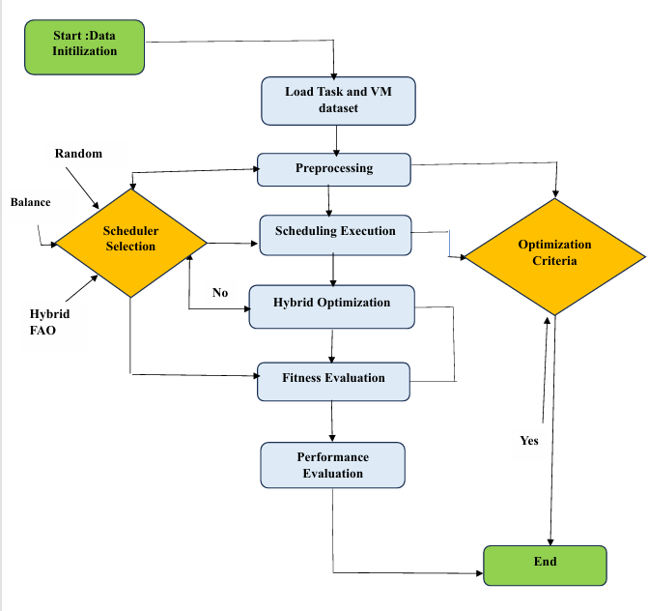
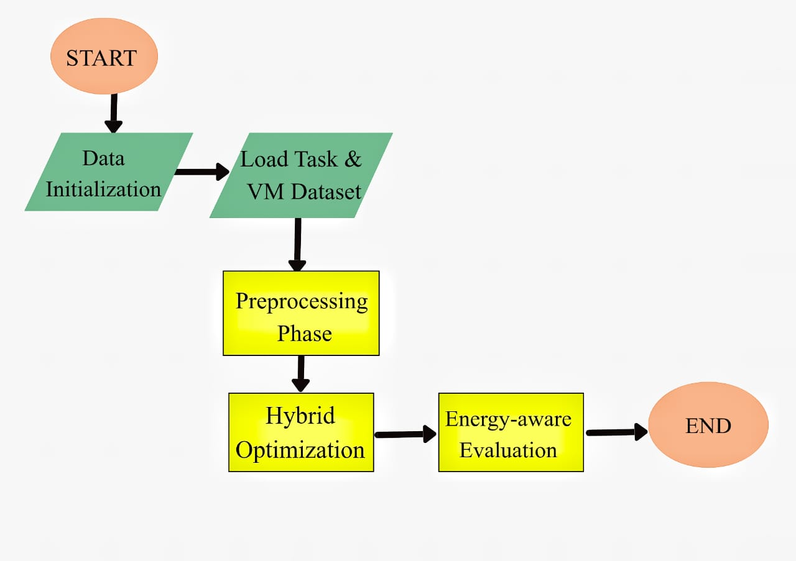
Methodology
Figure 2: System Architecture of the Proposed Hybrid FAO Model

Slide 22
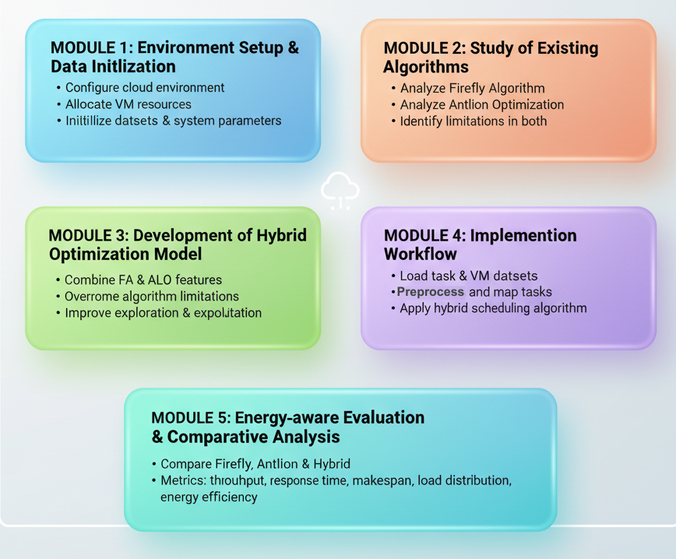
Module Of Methodology
22
A Hybrid Firefly–Antlion Optimizer with Energy-Aware Load Balancing for Sustainable Cloud Scheduling

Slide 23
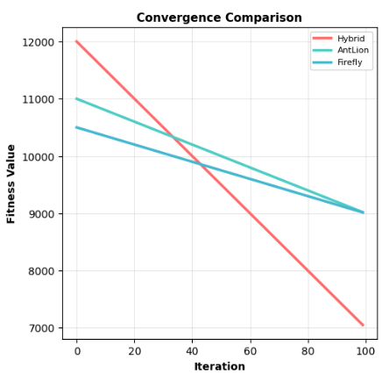
Experimental results/output/Snapshots
The fitness function here combines multiple objectives such as response time, energy consumption, and resource utilization using the following formula:
Fitness= w1​ × ResponseTime + w2 ​× EnergyCost − w3 ​× ResourceUtilization
Lower fitness indicates a better solution.
23
A Hybrid Firefly–Antlion Optimizer with Energy-Aware Load Balancing for Sustainable Cloud Scheduling

Slide 24
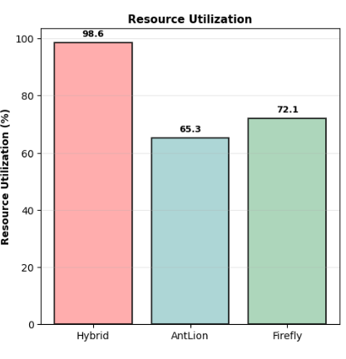

Experimental results/output/Snapshots
The formula implemented in the code is:
Here, ‘Total Resources Used’ is obtained by summing the capacity of all VMs that were assigned at least one task.
‘Total Available Resources’ is the total capacity of all VMs in the datacenter.
24
A Hybrid Firefly–Antlion Optimizer with Energy-Aware Load Balancing for Sustainable Cloud Scheduling

Slide 25
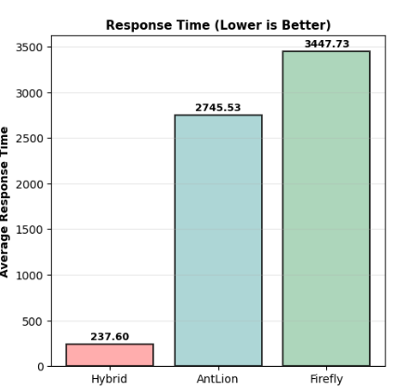

Experimental results/output/Snapshots
The formula used is:
Lower values mean faster task scheduling and improved system responsiveness.
25
A Hybrid Firefly–Antlion Optimizer with Energy-Aware Load Balancing for Sustainable Cloud Scheduling

Slide 26
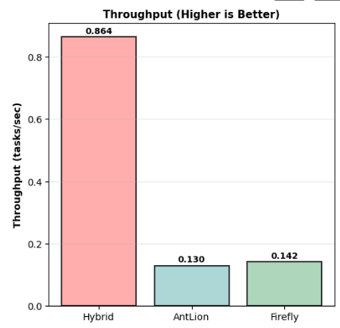
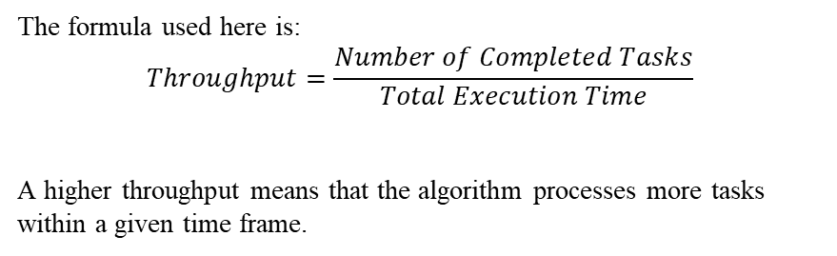
Experimental results/output/Snapshots
The formula used here is:
$$Throughput=\frac{Number of Completed Tasks}{Total Execution Time}$$
A higher throughput means that the algorithm processes more tasks within a given time frame.
26
A Hybrid Firefly–Antlion Optimizer with Energy-Aware Load Balancing for Sustainable Cloud Scheduling

Slide 27
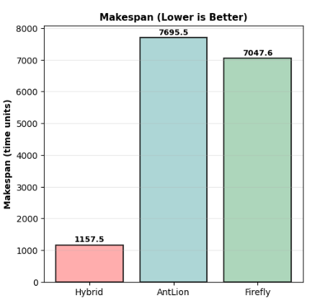
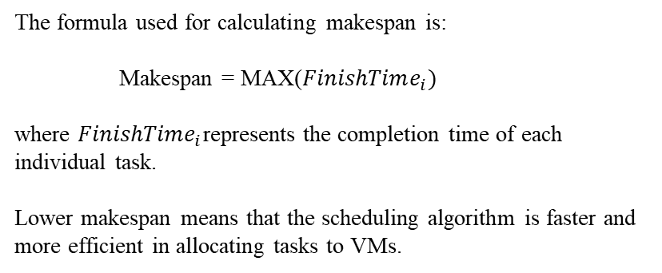
Experimental results/output/Snapshots
The formula used for calculating makespan is:
Makespan = MAX($FinishTime_{i})$
where $FinishTime_{i}$represents the completion time of each individual task.
Lower makespan means that the scheduling algorithm is faster and more efficient in allocating tasks to VMs.
27
A Hybrid Firefly–Antlion Optimizer with Energy-Aware Load Balancing for Sustainable Cloud Scheduling

Slide 28
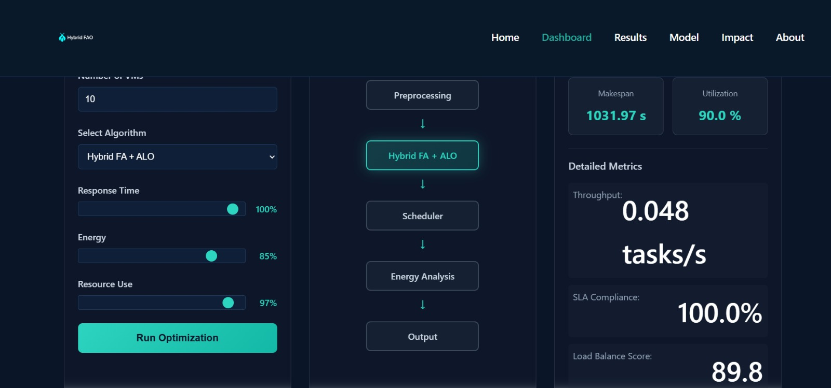
User Interface of System Model
28
A Hybrid Firefly–Antlion Optimizer with Energy-Aware Load Balancing for Sustainable Cloud Scheduling

Slide 29
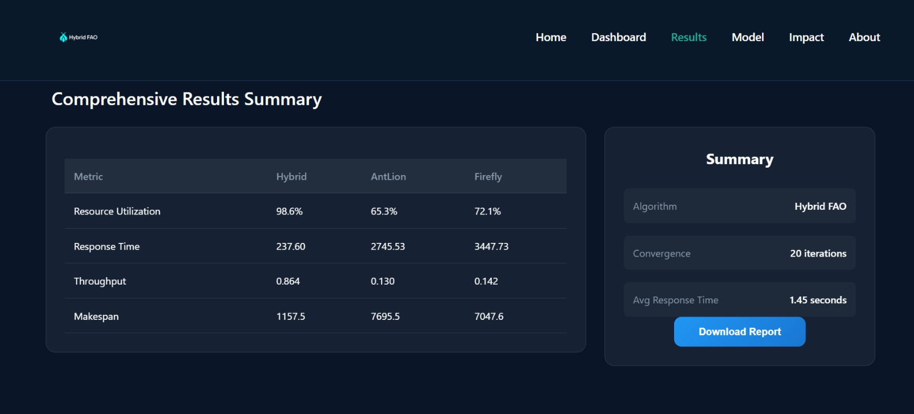
User Interface of System Model
29
A Hybrid Firefly–Antlion Optimizer with Energy-Aware Load Balancing for Sustainable Cloud Scheduling

Slide 30
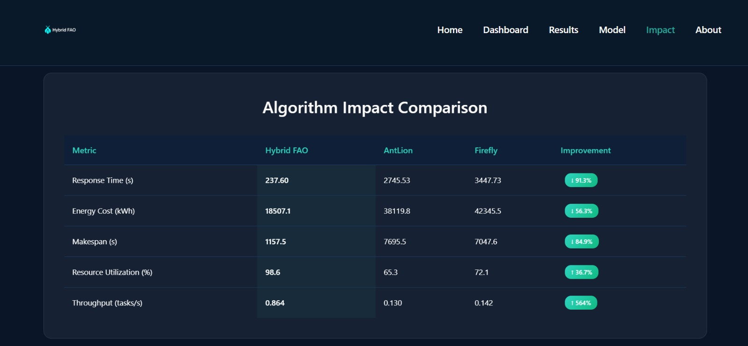
User Interface of System Model
30
A Hybrid Firefly–Antlion Optimizer with Energy-Aware Load Balancing for Sustainable Cloud Scheduling

Slide 31
Plan of Action
Activity (2024-25) | July-Aug | Aug-Sept | Sept-Oct | Oct-Nov | Nov-Dec
Literature Survey | Complete
Analysis of literature data | Complete
Dataset Preparation | complete
Proposed Methodology |  | complete
Algorithm Selection/ Experimentation |  |  | complete
Result Evaluation/Testing |  |  |  |  | Complete
Preparation of Project Report/Paper Writing |  |  |  |  | Complete
A Hybrid Firefly–Antlion Optimizer with Energy-Aware Load Balancing for Sustainable Cloud Scheduling
25

Slide 32

Conclusion and Future scope
Future Scope
The hybrid Firefly–Antlion Optimizer (FAO) approach has strong potential for further development. Future work can focus on:
Refining the model to improve accuracy while reducing computational overhead.
Implementing real-time task management for dynamic and faster scheduling.
Extending applications to diverse domains such as cloud computing, IoT networks, and industrial automation.
A Hybrid Firefly–Antlion Optimizer with Energy-Aware Load Balancing for Sustainable Cloud Scheduling

Slide 33
Conclusion and Future scope
Conclusion
The Hybrid Firefly–Antlion Optimizer (FAO) with Energy-Aware Load Balancing improves performance and efficiency in distributed computing by combining local and global search methods. It enhances task scheduling accuracy, balances workloads, and reduces energy consumption. The results confirm its effectiveness in dynamic environments, making it a reliable solution for better decision-making and system performance.
A Hybrid Firefly–Antlion Optimizer with Energy-Aware Load Balancing for Sustainable Cloud Scheduling

Slide 34
How it is useful for Society
Energy Efficiency & Sustainability: Reduces energy consumption in cloud data centers, contributing to lower carbon emissions and a greener environment.
Cost Savings: Efficient resource utilization lowers operational costs for cloud service providers, which can benefit businesses and consumers.
Improved Cloud Performance: Faster task execution and better load balancing enhance user experience for online services, apps, and digital platforms.
Supports Green Technology: Promotes sustainable IT practices, helping society move toward environmentally responsible computing.
Scalable Solutions: Enables large-scale cloud applications in education, healthcare, and smart cities to run more efficiently, benefiting societal development.
A Hybrid Firefly–Antlion Optimizer with Energy-Aware Load Balancing for Sustainable Cloud Scheduling

Slide 35
References
S. R. Al-Emari, Y. Sanjalawe, and B. A. Allehyani, "Optimizing Cloud Load Balancing with a Hybrid Bio-Inspired Approach: Enhancing Performance and Scalability," in Proc. 2025 1st Int. Conf. Computational Intelligence Approaches and Applications (ICCIAA), Amman, Jordan, Jun. 2025.
M. Shrimal, A. K. Sharma and M. Patel, "A Novel Hybrid Load Balancing Method to Achieve Quality of Service(QoS) in Cloud-Based Environments," 2024 3rd International Conference on Sentiment Analysis and Deep Learning (ICSADL), Bhimdatta, Nepal, 2024.
J. Gao, "Simulation Design of Load Balancing Optimization for Cloud Computing Data Stream Storage Based on Big Data Algorithms," 2024 Asia-Pacific Conference on Software Engineering, Social Network Analysis and Intelligent Computing (SSAIC), New Delhi, India, 2024.
A Hybrid Firefly–Antlion Optimizer with Energy-Aware Load Balancing for Sustainable Cloud Scheduling

Slide 36
References
4. R. R. Dornala, "An Advanced Multi-Model Cloud Services using Load Balancing Algorithms," 2023 5th International Conference on Inventive Research in Computing Applications (ICIRCA), Coimbatore, India, 2023, pp. 1065-1071
5. D. Girsa, D. Chauhan and D. Sharma, "Optimised Load Balancing for Green Cloud Computing," 2023 13th International Conference on Cloud Computing, Data Science & Engineering (Confluence), Noida, India, 2023, pp. 171-175.
6. R. Bundela, N. Dhanda and R. Verma, "Load Balanced Web Server on AWS Cloud," 2022 International Conference on Computing, Communication, and Intelligent Systems (ICCCIS), Greater Noida, India, 2022, pp. 114-118.
A Hybrid Firefly–Antlion Optimizer with Energy-Aware Load Balancing for Sustainable Cloud Scheduling

Slide 37
References
7. S. Swarnakar, R. Kumar, S. Krishn and C. Banerjee, "Improved Dynamic Load Balancing Approach in Cloud Computing," 2020 IEEE 1st International Conference for Convergence in Engineering (ICCE), Kolkata, India, 2020.
8. H. Rai, S. K. Ojha and A. Nazarov, "Cloud Load Balancing Algorithm," 2020 2nd International Conference on Advances in Computing, Communication Control and Networking (ICACCCN), Greater Noida, India, 2020.
9. A. Jyoti, M. Shrimali and R. Mishra, "Cloud Computing and Load Balancing in Cloud Computing -Survey," 2019 9th International Conference on Cloud Computing, Data Science & Engineering (Confluence), Noida, India, 2019.
10. S. Joshi and U. Kumari, "Load balancing in cloud computing: Challenges & issues," 2016 2nd International Conference on Contemporary Computing and Informatics (IC3I), Greater Noida, India, 2016, pp. 120-125.
A Hybrid Firefly–Antlion Optimizer with Energy-Aware Load Balancing for Sustainable Cloud Scheduling

Slide 38
Roles & Responsibility
Team member Details | Roles and Responsibility
Aarohi Waghmare-1(01) | Research & Algorithm Analyst
Diksha Bhagwat-2(08) | Optimization Algorithm Developer
Giteshwari Lanjewar-3(09) | Frontend Developer
Sanchyee Pendam-4(19) | Data Preparation & Simulation Engineer
Srushti Bawane -5(25) | Documentation & Presentation Coordinator
Vaishnavi Rathod-6(29) | Experimental Results & Visualization Specialist
38
A Hybrid Firefly–Antlion Optimizer with Energy-Aware Load Balancing for Sustainable Cloud Scheduling

Slide 39
Thank You…….

